Slide 1
Mehran S. Fallah June 2020
Programming Languages
Session VIII
Lisp

Slide 2
Introduction
We have introduced the lambda-calculus and functional programming languages in previous sessions.
Lisp (historically LISP), in full LISt Processor, is a historically important language that is good for illustrating a number of general points about programming languages, especially functional Languages.
Lisp was founded on the mathematical theory of recursive functions.
A Lisp program is indeed a function applied to data, rather than being a sequence of procedural steps as in Fortran.
Lisp is the second-oldest high-level programming language in widespread use today. Only Fortran is older, by one year. Lisp was originally specified in 1958.
It was based on the ideas that had been developed earlier in the study of the lambda-calculus. The use of higher-order functions is central to the language.
Knowing Lisp may help you think about programming in a different way. Lisp shows that many goals of programming language design can be met in a simple, elegant way.

Slide 3
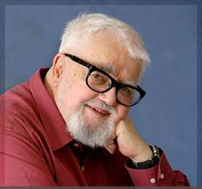
Introduction (Ctd.)
The Lisp programming language was developed at MIT in the late 1950s for research in artificial intelligence (AI) and symbolic computation.
Today, the best-known general-purpose Lisp dialects are Racket, Common Lisp, Scheme, and Clojure.
Lists comprise the main data structure of Lisp, hence the name. The strength of Lisp is its simplicity and flexibility. It has been widely used for exploratory programming.
Exploratory programming is often used in the development of AI programs, as a researcher may not know how the program should accomplish a task until several unsuccessful programs have been tested.
The popular text editor emacs is written in Lisp, as is the linux graphical toolkit gtk and many other programs in current use in a variety of computing environments.
McCarthy’s 1960 paper on Lisp, called “Recursive functions of symbolic expressions and their computation by machine” is an important historical document with many good ideas.

Slide 4
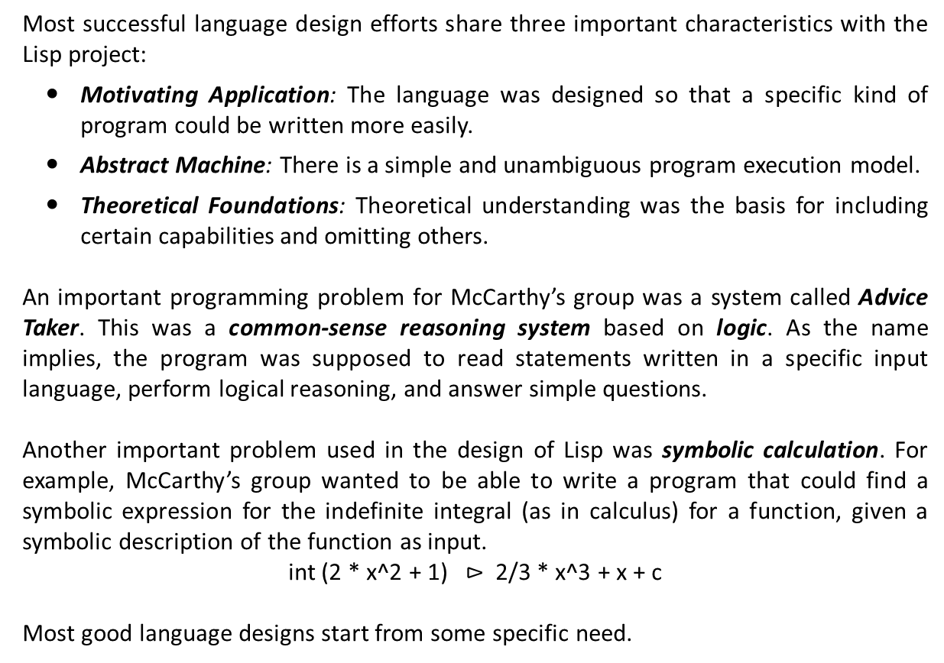
Good Language Design
Most successful language design efforts share three important characteristics with the Lisp project:
Motivating Application: The language was designed so that a specific kind of program could be written more easily.
Abstract Machine: There is a simple and unambiguous program execution model.
Theoretical Foundations: Theoretical understanding was the basis for including certain capabilities and omitting others.
An important programming problem for McCarthy’s group was a system called Advice Taker. This was a common-sense reasoning system based on logic. As the name implies, the program was supposed to read statements written in a specific input language, perform logical reasoning, and answer simple questions.
Another important problem used in the design of Lisp was symbolic calculation. For example, McCarthy’s group wanted to be able to write a program that could find a symbolic expression for the indefinite integral (as in calculus) for a function, given a symbolic description of the function as input.
int (2 * x^2 + 1) $⊳$ 2/3 * x^3 + x + c
Most good language designs start from some specific need.

Slide 5
Good Language Design (Ctd.)
For comparison, here are some motivating problems that were influential in the design of other programming languages:
Lisp Symbolic computation, logic, experimental programming
C Unix operating system
PL/1 Tried to solve all programming problems; not successful or influential
A specific, motivating application helps language designers to solve one of the hardest problems in programming language design: deciding which features to leave out.
The language design may either be very concrete, prescribing exactly how the parts of the language must be implemented, or more abstract, specifying only certain properties that must be satisfied in any implementation. It is possible to err in either direction.
A language that is too closely tied to one machine will lead to programs that are not portable. At the other extreme, if a language design specifies only what the eventual value of an expression must be, without any information about how it is to be evaluated, it may be difficult for programmers to write efficient code. Lisp was designed for a specific machine, the IBM 704. However, if the designers had built the language around a lot of special features of a particular computer, the language would not have survived as well as it has.

Slide 6
Good Language Design (Ctd.)
A systematic, predictable machine model is critical to the success of a programming language. For comparison, here are some execution models associated with the design of other programming languages:
Fortran Flat register machine
No stacks, no recursion
Memory arranged as linear array
Algol family Stack of activation records
Heap storage
Smalltalk Objects, communicating by messages
McCarthy described Lisp as a “scheme for representing the partial recursive functions of a certain class of symbolic expressions.”
Lisp was designed to be Turing complete, meaning that all partial recursive functions may be written in Lisp. The use of function expressions and recursion in Lisp take direct advantage of a mathematical characterization of computable functions based on the lambda-calculus.
Today it is unlikely that a team of programming language designers would advertise that their language is Turing complete. However, computability theory and other theoretical frameworks such as type theory continue to have important consequences for programming language design.
The connection between Lisp and the lambda-calculus is important, and the lambda-calculus remains an important tool in the study of programming languages.

Slide 7
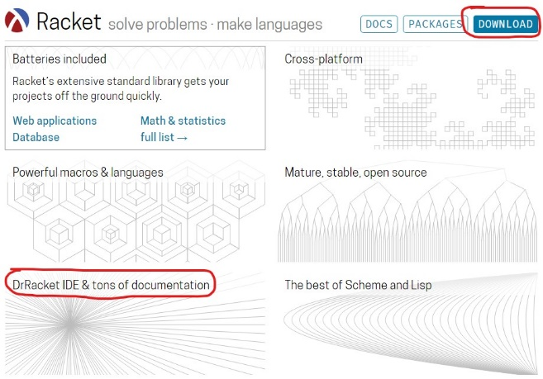
An Overview of Lisp
The language described here might be called Historical Lisp. It is essentially Lisp 1.5, from the early 1960s, with one or two minor changes. Because there are several different versions of Lisp in common use, it is likely that some function names used here will differ from those you may have used in previous Lisp programming.
Lisp syntax is extremely simple. To make parsing easy, all operations are written in prefix form, with the operator in front of all the operands. Here are some examples of Lisp expressions, with corresponding infix form for comparison.
Lisp prefix notation Infix notation
(+ 1 2 3 4 5) (1 + 2 + 3 + 4 + 5)
(∗ (+ 2 3) (+ 4 5)) ((2 + 3) ∗ (4 + 5))
(f x y) f(x, y)
An engaging book that captures some of the spirit of contemporary Lisp is titled The Little Schemer (MIT Press, Cambridge, MA, 1995).
You may also download and install Racket on your machine, and practice writing and running Racket programs (https://racket-lang.org/).

Slide 8
Atoms and S-Expressions
Lisp programs compute with atoms and cells. Atoms include integers, floating-point numbers, and symbolic atoms. Symbolic atoms may have more than one letter. Here, we use only integers and symbolic atoms.
The atoms are given by the following BNF grammar:
<atom> ::= <smbl> | <num>
<smbl> ::= <char> | <smbl><char> | <smbl><digit>
<num> ::= <digit> | <num><digit>
An atom that is used for some special purposes is the atom nil.
The basic data structures of Lisp are dotted pairs, which are pairs written with a dot between the two parts of the pair. Putting atoms or pairs together, we can write symbolic expressions in a form traditionally called S-expressions. The syntax of Lisp S-expressions is given by the following grammar:
<sexp> ::= <atom> | (<sexp> . <sexp>)
Although S-expressions are the basic data of Historical Lisp, most Lisp programs actually use lists. Lisp lists are built out of pairs in a particular way.

Slide 9
Functions and Special Forms
The basic functions of Historical Lisp are the operations
cons car cdr eq atom
on pairs and atoms, together with the general programming functions
cond lambda define quote eval.
We also use numeric functions such as +, –, and ∗, writing these in the usual Lisp prefix notation.
The function cons is used to combine two atoms or lists, and car and cdr take lists apart. The function eq is an equality test and atom tests whether its argument is an atom.
The general programming functions include cond for a conditional test (if … then … else …), lambda for defining functions, define for declarations, quote to delay or prevent evaluation, and eval to force evaluation of an expression.
The functions cond, lambda, define, and quote are technically called special forms since an expression beginning with one of these special functions is evaluated without evaluating all of the parts of the expression.
The language summarized up to this point is called pure Lisp. A feature of pure Lisp is that expressions do not have side effects. This means that evaluating an expression only produces the value of that expression.

Slide 10
Evaluation of Expressions
The basic structure of the Lisp interpreter or compiler is the read-eval-print loop. In general, we evaluate a Lisp expression
(function arg₁ … arg_{n})
by evaluating each of the arguments in turn, then passing the list of argument values to the function.
The exceptions to this rule are called special forms. For example, we evaluate a conditional expression
(cond (p₁ e₁) . . . (p_{n} e_{n}))
by proceeding from left to right, finding the first p_{i} with a value different from “nil.”
Lisp uses the atoms T and nil (#t or true and #f or false in Scheme and Racket) for true and false, respectively.
A slightly tricky point is that the Lisp evaluator needs to distinguish between a string that is used to name an atom and a string that is used for something else, such as the name of a function. The form quote is used to write atoms and lists directly:
(quote cons) expression whose value is the atom “cons”
(cons a b) expression whose value is the pair containing the values of a and b
(cons (quote A) (quote B)) expression whose value is the pair containing the atoms “A” and “B”

Slide 11
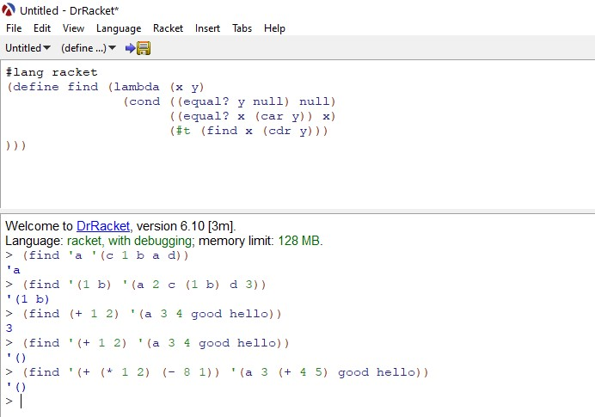
Evaluation of Expressions (Ctd.)
In most dialects of Lisp, it is common to write ‘bozo instead of (quote bozo). You can see from the preceding brief description that quote must be a special form. Here are some additional examples of Lisp expressions and their values:
(+ 4 5) expression with value 9
(+ (+ 1 2) (+ 4 5)) first evaluate 1+2, then 4+5, then 3+9 to get value 12
(quote (+ 1 2)) evaluates to a list (+ 1 2)
‘(+ 1 2) same as (quote (+ 1 2))
Example 1. Here is a slightly longer Lisp program example, the definition of a function that searches a list. The find function takes two arguments, x and y, and searches the list y for an occurrence of x. The declaration begins with define, which indicates that this is a declaration. Then follows the name find that is being defined, and the expression for the find function:
(define find (lambda (x y)
(cond ((equal y nil) nil)
((equal x (car y)) x)
(true (find x (cdr y)))
)))

Slide 12
Innovations in the Design of Lisp
Just as virtually all natural languages have certain basic parts of speech, such as nouns, verbs, and adjectives, there are programming language parts of speech that occur in most languages. The most basic programming language parts of speech are expressions, statements, and declarations.
Traditional machine languages and assembly languages are based on statements. Lisp is an expression-based language, meaning that the basic constructs of the language are expressions, not statements. In fact, pure Lisp has no statements and no expressions with side effects.
Fortran and assembly languages used before Lisp had conditional statements. A typical statement might have the form
if (condition) go to 112.
However, conditional expressions that produce a value instead of causing a jump were new in Lisp.
The Lisp conditional expression
(cond (p₁ e₁) . . . (p_{n} e_{n})).
The value of this expression is the first e_{i}, proceeding from left to right, with p_{i} nonnil and p_{j} nil (representing false) for all j < i. If there is no such e_{i} then the conditional expression has no value.

Slide 13
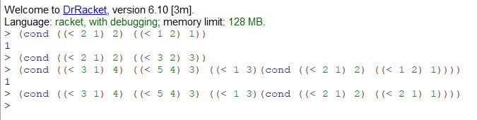
Innovations in the Design of Lisp (Ctd.)
It is worth noting that (cond (p₁ e₁) . . . (p_{n} e_{n})) is undefined if
p₁, . . . , p_{n} are all nil,
p₁, . . . , p_{i} are false and p_{i+1} is undefined, and
p₁, . . . , p_{i} are false, p_{i+1} is true, and e_{i+1} is undefined.
Here are some example conditional expressions and their values:
(cond ((< 2 1) 2) ((< 1 2) 1)) has value 1
(cond ((< 2 1) 2) ((< 3 2) 3)) is undefined
(cond (diverge 1) (true 0)) is undefined, if diverge does not terminate
(cond (true 0) (diverge 1)) has value 0
An important part of the Lisp “cond” expression is that a conditional expression may have a value even if one or more subexpressions do not. For example,
(cond (true e₁) (false e₂))
may be defined even if e₂ is undefined. In contrast, e₁ + e₂ is undefined if either e₁ or e₂ is undefined.
In standard programming language terminology, an operator or expression form is strict if all operands or subexpressions are evaluated. Lisp “cond” is not strict, but addition is. (Some operators from C that are not strict are && and ||.)

Slide 14
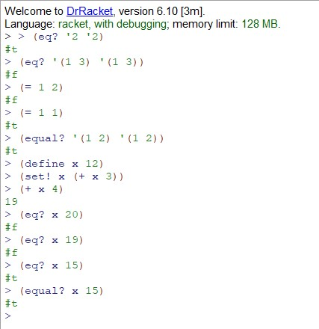
Innovations in the Design of Lisp (Ctd.)
The abstract machine for Pure Lisp has four parts:
A Lisp expression to be evaluated.
A continuation, which is a function representing the remaining program to evaluate when done with the current expression.
An association list, commonly called the A-list in much of the literature on Lisp and called the run-time stack in the literature on Algol-based languages. The purpose of the A-list is to store the values of variables that may occur either in the current expression to be evaluated or in the remaining expressions in the program.
A heap, which is a set of cons cells (pairs stored in memory) that might be pointed to by pointers in the A-list.
There are four main equality functions in Lisp: eq, eql, equal, and =.
The function eq tests whether its arguments are represented by the same sequence of memory locations, and = is numeric equality.
The function eql tests whether its arguments are the same symbol or number.
The function equal is a recursive equality test on lists or atoms that is implemented by use of eq and =.

Slide 15
Concepts in Programming Languages (Chapter 3)

